Slide 1



Pokémon Top trumps game
Mia and Millie

Slide 2
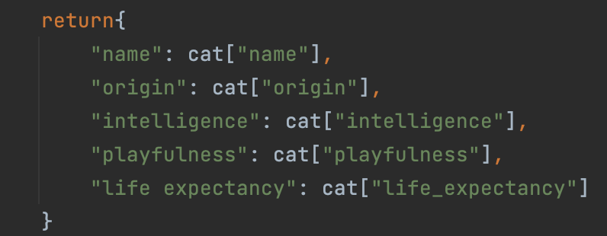
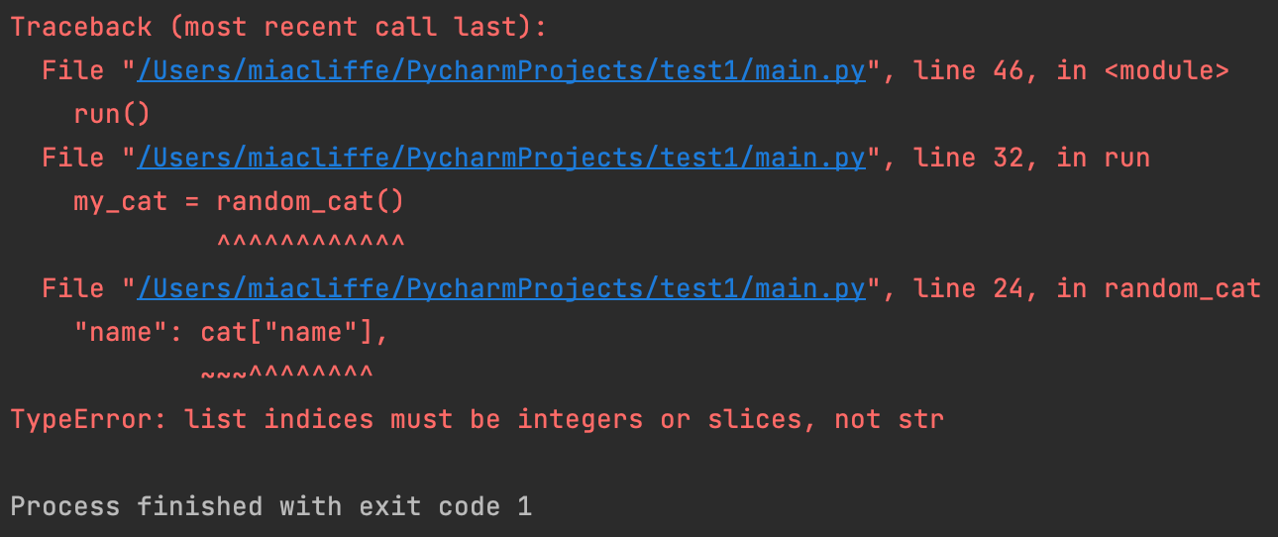
Issues with cat api
We originally used a cat API but were having issues:
- Error message: "TypeError: list indices must be integers or slices, not str"
- Because this wasn't working, several other related lines threw up errors too
- We guessed the error meant we needed numbers instead of strings in the return part of the definition
- But there were no numbers to reference in the cat API so we couldn't figure out how to get it to pull the stats! We decided to replace the cats API with the Pokémon API for sake of time. It worked!

Slide 3
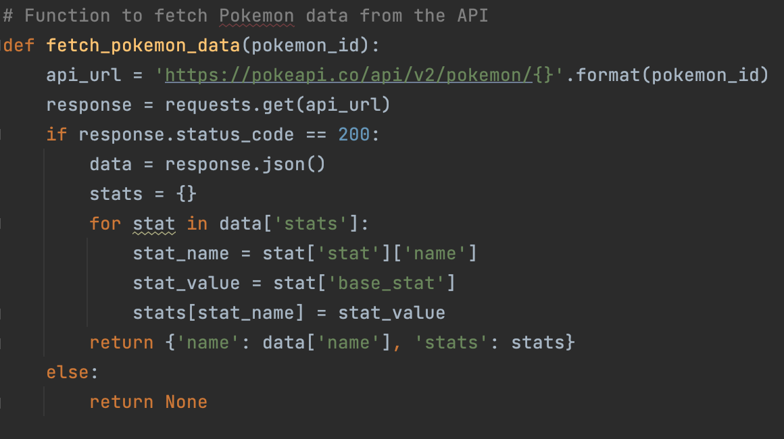
Getting data from the Pokémon api
Notes:
This code defines a function called fetch_pokemon_data that takes a single argument pokemon_id representing the ID of a Pokemon. The function returns a dictionary containing the name of the Pokemon and its base stats.
The function first constructs a URL to the PokeAPI for the given Pokemon ID using the api_url variable. It then makes a request to the API using the requests.get function, passing the constructed URL as an argument.
If the request returns a response with a status code of 200 (OK), indicating that the request was successful, the function extracts the data from the response.
The function then creates an empty dictionary called stats, and iterates over the stats list in the JSON data returned by the API. For each stat, it extracts the name and base value, and adds them as key-value pairs to the stats dictionary.
Finally, the function constructs and returns a dictionary containing the Pokemon's name and its stats dictionary. If the API request fails for any reason, the function returns None.

Slide 4

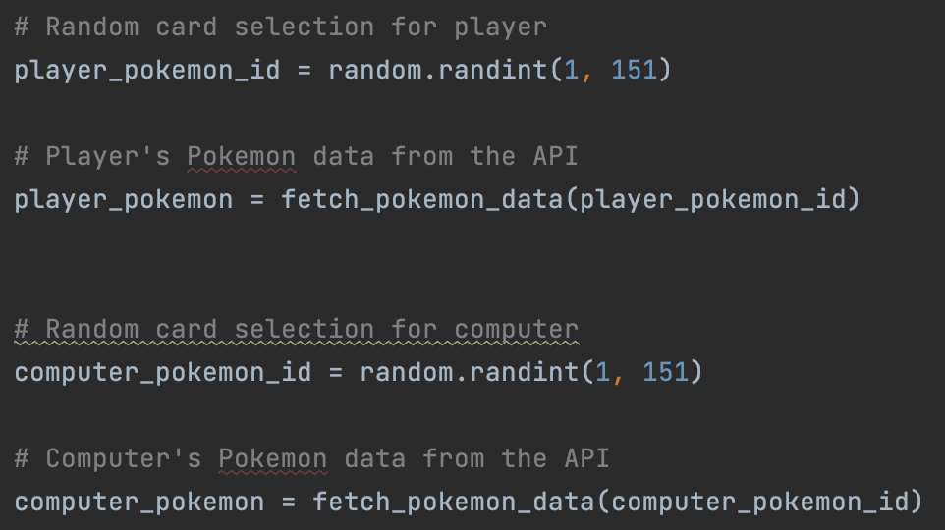
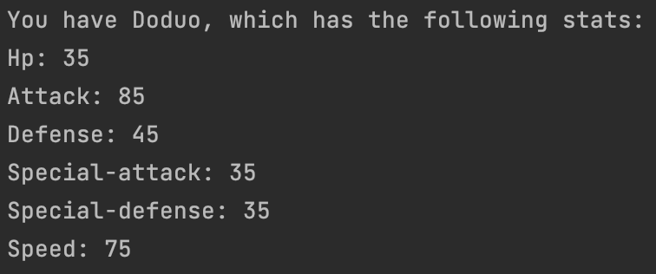
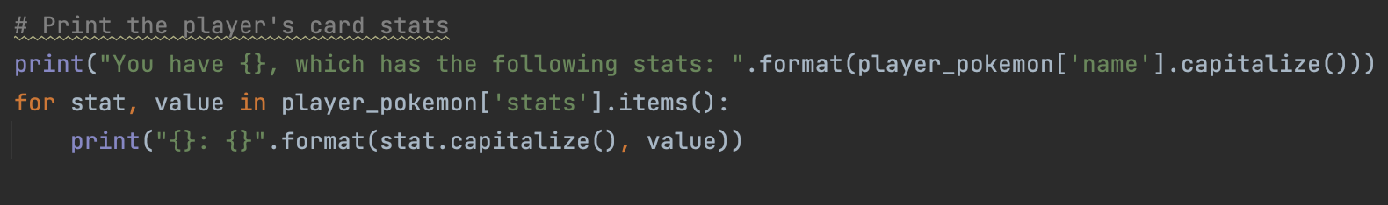
How the Pokémon is chosen
Notes:
First we import random so we can generate random numbers later on
Then we made it so for the player and computer, a random number was chosen from 1-151 (because that’s how many pokemons the API offered to choose from and then linked the number that was chosen to the API data to allocate the player and computer their pokemon to play against each other with
Then we added the print function so that we could see the stats for the pokemon that was randomly chosen for the player

Slide 5
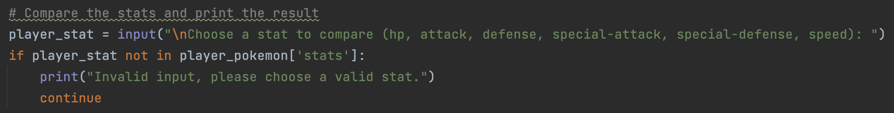

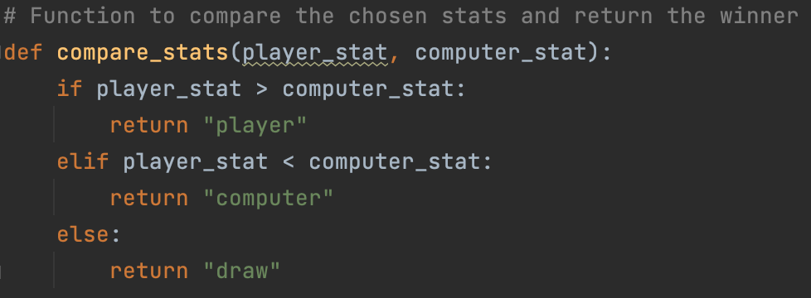
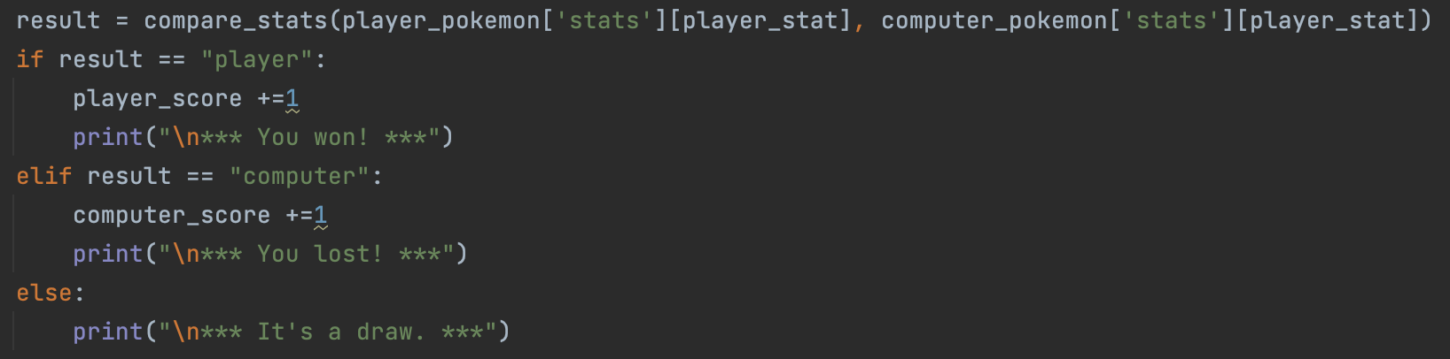
How do you win?
Notes:
First you have to choose the stat you want to use. If you mistype and spell something wrong, the continue function will let you answer again instead of stopping and coming up with a scary red error code and ruining the flow
Then used the define function to compare the stat chosen by us for player and computer. So logically is the players stat is higher it returns player or vice versa the computer, otherwise it is a draw
This then links to the print function whether you win, lose or draw

Slide 6
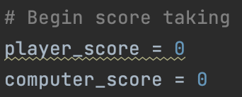

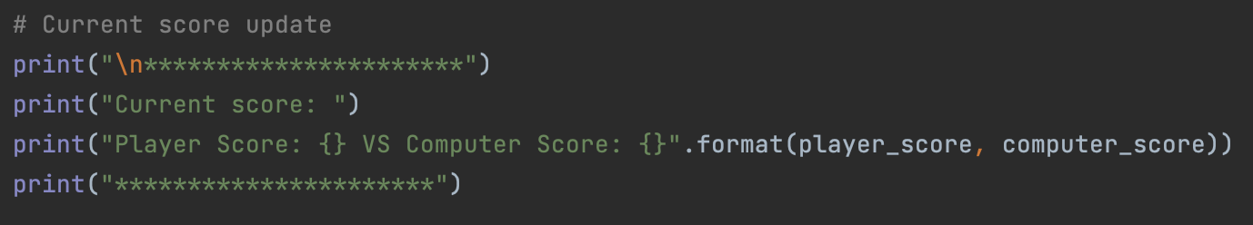
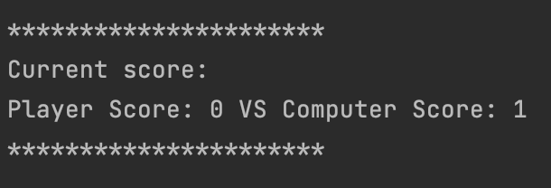
Score feature
Notes:
As an extension we added a score feature. So to begin the scores are set to zero. When the stats are compared to find a winner, it is linked to the scoring. So if your stat is higher, player is returned and it will print that you win AND add 1 to your score. At the end of the round we added a print function to show the current score

Slide 7
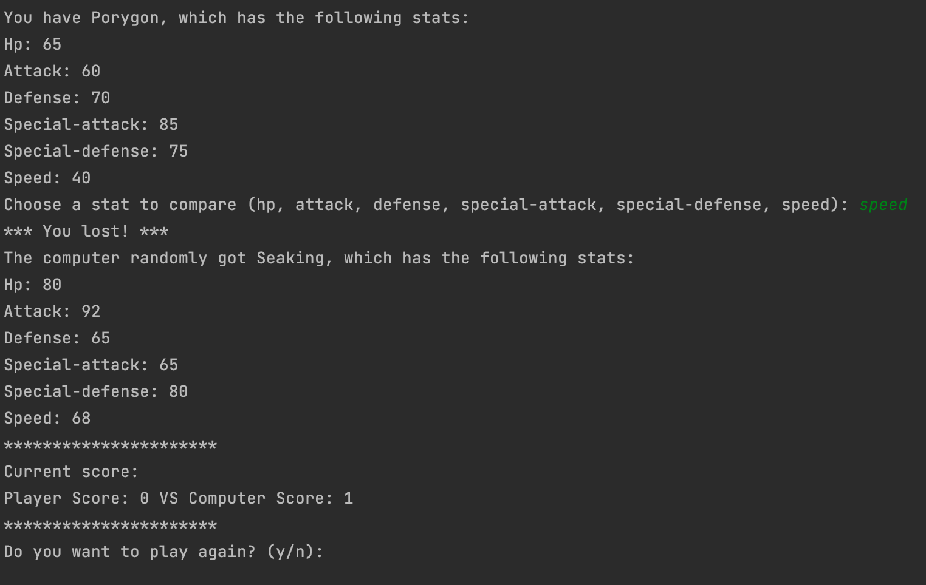
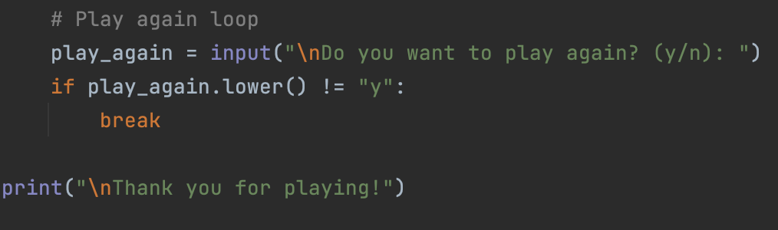
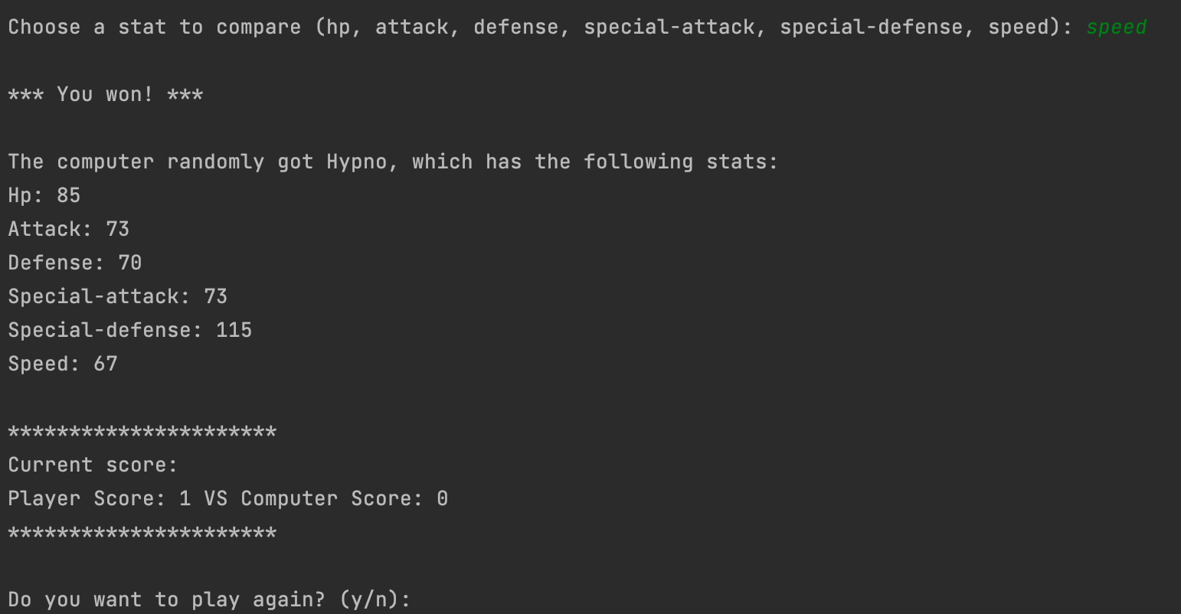
Readability
Notes:
These are some things we added that didn’t affect the functioning of the code but were just for readability while playing. Using the backslash n adds new lines so then when playing the blocks of information are separated instead of being one big cramped lump of information.

Slide 8
Readability
Notes:
It really irritated me not having the name of the pokemon in capitals and so I added the .capitalize which fixed this for me

Slide 9

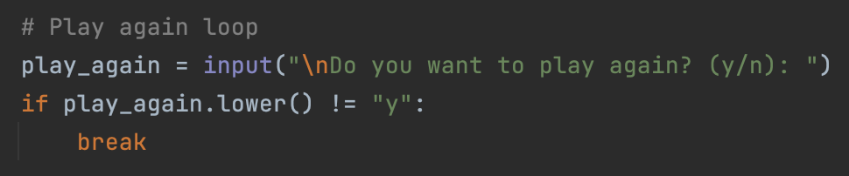
Playability
Notes:
Again this isn’t essential for the code to work but I think it adds to the playability experience. I saw someone else use this break function and liked it. Basically the while true creates a loop and the break function ends it. So the loop of the game can continue until you enter that you don’t want to play again and the loop is terminated

